Slide 1
SharePoint Online
Notes:
Welcome Everyone to the course

Slide 2



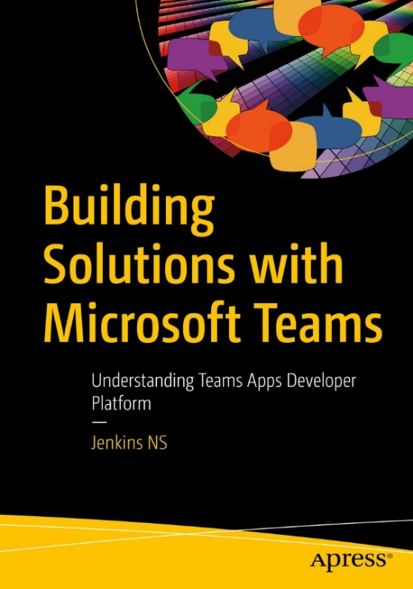








Jenkins NS
Modern Workplace Solution Architect | Consultant
18+ Years of experience
Power Platform, Microsoft Teams, and SPFx Specialist
International Speaker | Author | Trainer
SPS/M365 Bangalore Organizer
aOS Ambassador
jenkinsns@gmail.com
in/jenkinsns
@jenkinsns
http://www.jenkinsblogs.com
https://www.youtube.com/user/jenkinsns

Slide 3
Lesson Introduction
Overview of SharePoint in Microsoft 365
SharePoint integration with Microsoft 365
SharePoint integration with Power Platform
SharePoint service description
SharePoint Administrator in Microsoft 365
New SharePoint Admin Center
Classic SharePoint Admin Center
SharePoint Online Management Shell

Slide 4
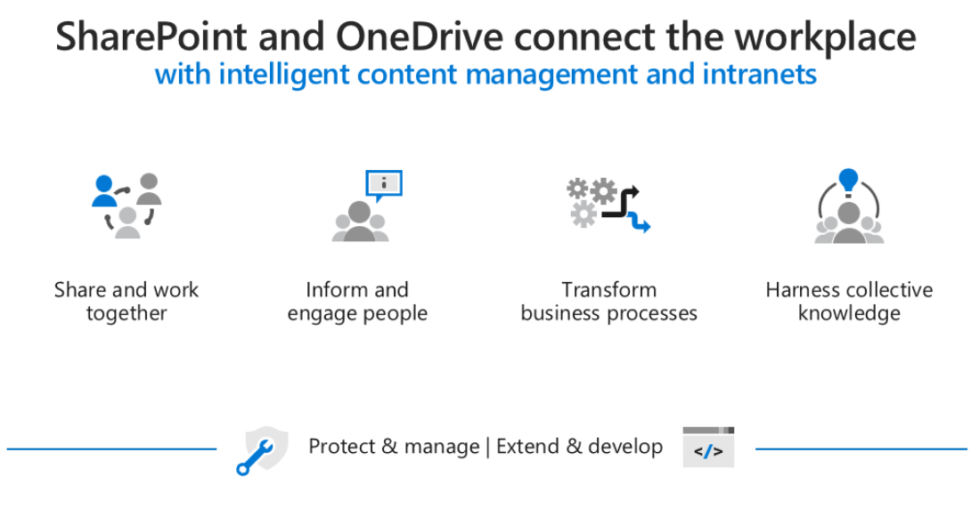
Overview of SharePoint in Microsoft 365
SharePoint is a Microsoft 365 service that enables sharing and collaboration across your organization. Organizations can share and manage content, knowledge, and applications to empower teamwork, quickly find information, and seamlessly collaborate across the organization.
Organizations use Microsoft SharePoint to create websites. Users can use it as a secure place to store, organize, share, and access information from any device. All they need is a web browser, such as Microsoft Edge, Internet Explorer, Chrome, or Firefox.

Slide 5
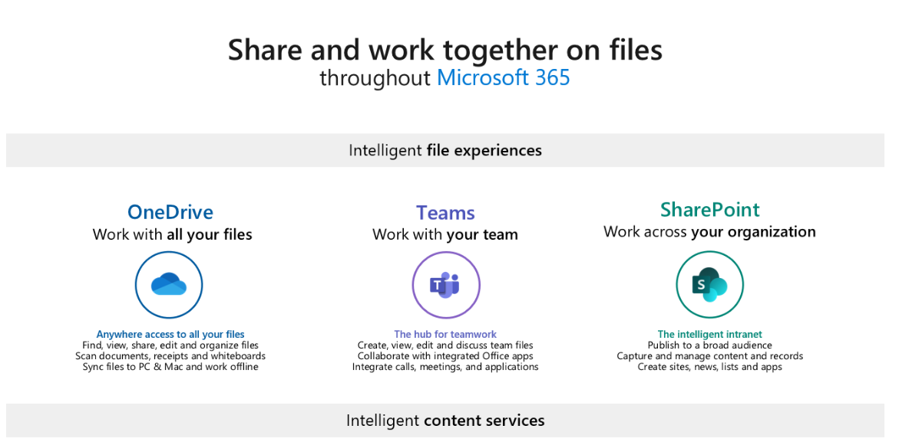
SharePoint integration with Microsoft 365
SharePoint is a Microsoft 365 service that enables sharing and collaboration across your organization. SharePoint can be integrated with Microsoft Teams, OneDrive, and a variety of governance and security options all play a role in creating a rich environment where users can collaborate easily, and your organization's sensitive content remains secure.
SharePoint and Microsoft 365 Groups
SharePoint and Microsoft Teams

Slide 6
SharePoint integration with Power Platform (1/2)
SharePoint is integrated with a variety of other services to provide a much richer experience. With Power Platform, Organizations can streamline business processes.
Organizations can build custom applications that can automate routine processes and supply a structure with tools like Power Apps and Power Automate.

Slide 7
SharePoint integration with Power Platform (2/2)
Power Apps
Power Apps provides a rapid low code development environment for building custom apps for business needs. Power Apps can be used to create custom forms for use in modern SharePoint sites.
Power Automate
Power Automate lets users create automated workflows between applications and services. SharePoint site admins can use Power Automate to require new or updated site pages to be approved before being published.
Power BI
Power BI (Business Intelligence) is a business analytics service that delivers insights for analyzing data. With Power BI's report web part for SharePoint in Microsoft 365, users can easily embed interactive Power BI reports in SharePoint Online pages.

Slide 8
SharePoint service description
SharePoint in Microsoft 365 is a cloud-based service, hosted by Microsoft, for organizations of all sizes. Instead of installing and deploying SharePoint Server on-premises, any organization can subscribe to a Microsoft 365 plan or to the standalone SharePoint service in Microsoft 365.
Feature | Microsoft 365 Business Basic, Business Standard, or Business Premium | Microsoft 365 E3 or E5, Office 365 Enterprise E1, E3, or E5, or SharePoint Plan 1 or 2 | Microsoft 365 F1 or F3, Office 365 Enterprise F3
Total storage per organization | 1 TB plus 10 GB per license purchased | 1 TB plus 10 GB per license purchased | 1 TB
Max storage per site (site collection) | 25 TB | 25 TB | 25 TB
Sites (site collections) per organization | 2 million | 2 million | 2 million
Number of users | Up to 300 | 1- 500,000 | 1- 500,000

Slide 9
SharePoint Administrator in Microsoft 365
Global administrators in Microsoft 365 have all the permissions of a SharePoint administrator and can assign others to the SharePoint administrator role. Global administrators and SharePoint administrators don't have automatic access to all sites, but they can give themselves access to any sites if needed.
Key tasks of SharePoint administrators:
Create, delete, and restore SharePoint sites.
Register hub sites.
Manage site storage limits.
Manage site administrators.
Manage sharing settings at the organization level.
Manage advanced SharePoint features.
View reports to monitor file and user activity.

Slide 10
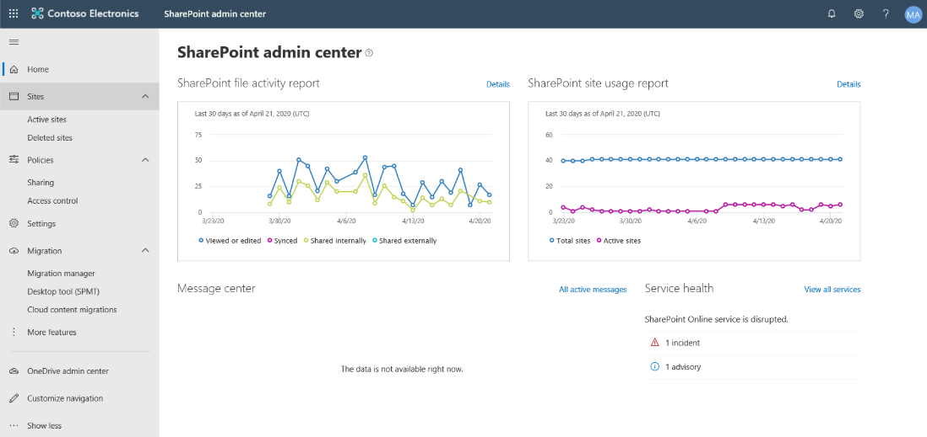
New SharePoint Admin Center (1/2)
The new SharePoint admin center provides a consistent admin experience across services in Microsoft 365 with modern principles.

Slide 11

New SharePoint Admin Center (2/2)
You can use the new SharePoint admin center to:
Monitor the environment at Home page and left pane, including
Create, delete, restore, and manage sites that belong to Microsoft 365 Groups and communication sites.
Link to the OneDrive admin center, SharePoint Migration Tool, and classic SharePoint admin center
A geo location selector for organizations that have set up Multi-Geo in OneDrive and SharePoint
Control Access by creating policies that restrict access from unmanaged devices, sign out users from inactive browser sessions, allow access from only specific IP addresses, and block access from apps that don't use modern authentication.
Manage settings for list and library experience, sync, notifications, site storage limits, default admin experience, and site creation.
Review pending and approved web API permissions and approve or reject access requests.

Slide 12
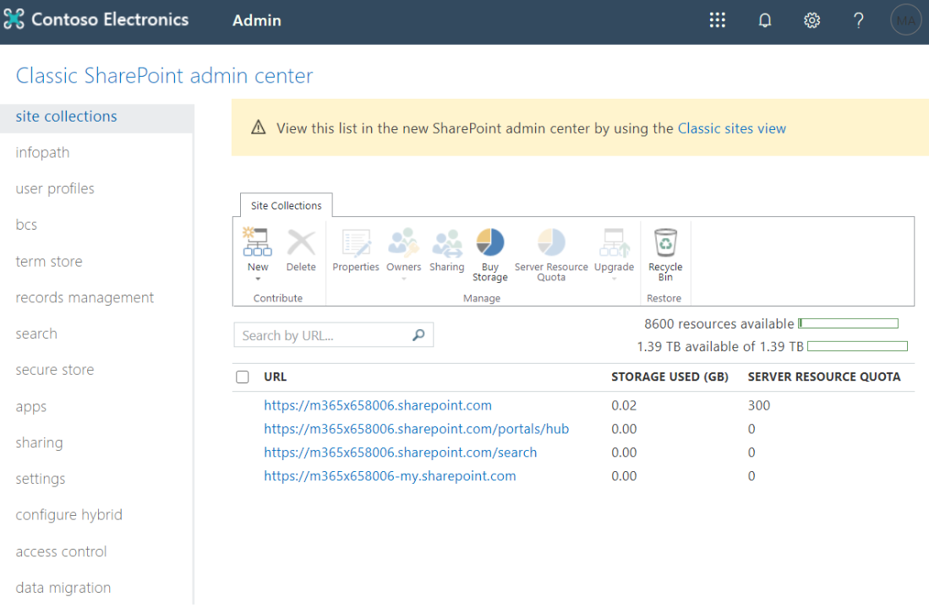
Classic SharePoint Admin Center (1/2)
While you can perform most SharePoint admin tasks from the new SharePoint admin center, you can still access the classic SharePoint admin center.

Slide 13

Classic SharePoint Admin Center (2/2)
You can use the classic SharePoint admin center to:
Create and manage classic site collections including allocating and monitoring site collection storage
Manage permissions and users and help secure content on sites
Manage user profiles and configure OneDrive settings (called “My Sites” settings in the admin center)
Enable and configure specific SharePoint Online features or global settings

Slide 14
SharePoint Online Management Shell
The SharePoint Management Shell is a Windows PowerShell module that lets you run command-line operations. SharePoint Admin can use it to manage SharePoint Online users, sites, and site collections.
SharePoint Admin role
Install SharePoint Online Management Shell
Connect SharePoint Online service
Install-Module –Name Microsoft.Online.SharePoint.PowerShell
Connect-SPOService -Url https://OrgName-admin.sharepoint.com

Slide 15
Lesson Introduction
Overview of SharePoint sites
Overview of navigation in SharePoint
Overview of SharePoint hub sites
Create SharePoint sites
Delete SharePoint sites
Restore SharePoint sites
Configure SharePoint hub sites

Slide 16
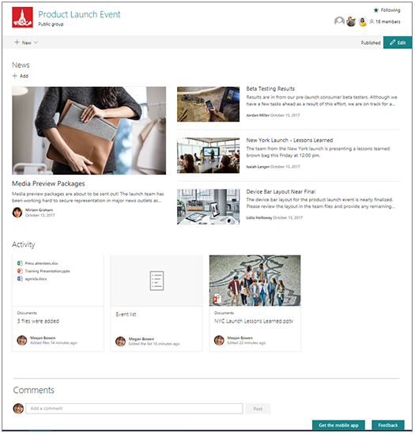
Overview of SharePoint sites (1/4)
Microsoft SharePoint offers a wide variety of options and tools to create intranet sites for your organization. The modern experience in Microsoft SharePoint is designed to be compelling, flexible, and more performant.
Team sites
Team sites are collaboration sites for each project team, department, and division in your organization. Team sites provide document storage and sharing, and support for custom lists, workflow integration with Power Automate, file libraries, and direct integration with Microsoft Teams.

Slide 17
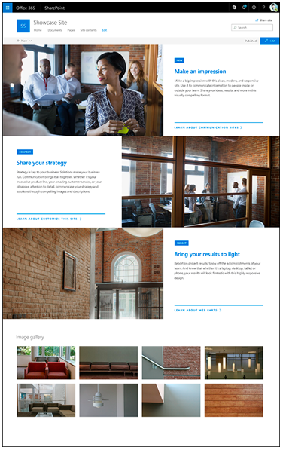
Overview of SharePoint sites (2/4)
Communication sites
Communication sites are designed to broadcast information to a large audience. Much like a team site, a communication site is a SharePoint site that anyone in the organization can create from the SharePoint start page.
Any of the templates can be customized by adding SharePoint web parts—dynamic page elements that display text, images, files, video, and a variety of other content types.

Slide 18
Overview of SharePoint sites (4/4)
Other SharePoint sites
Root site
SharePoint start page (formerly SharePoint home page)
Organization news site
Classic SharePoint sites

Slide 19
Overview of navigation in SharePoint (1/4)
Most visitors start their web experiences by navigating, including internal web sites. Good navigation experiences present visitors with a complete picture of what is available on the site and, combined with the home page, provide a comprehensive “story” for the site.
Planning an effective navigation experience is a critical element of designing SharePoint sites.

Slide 20

Overview of navigation in SharePoint (2/4)
There are several types of navigation in SharePoint:
Local navigation on an individual site
Local navigation is the persistent navigation that visitors see on every page of your site. For team sites, local navigation shows up on the left side of the page in the area referred to as the “quick launch.” For communication sites, local navigation shows up at the top of the page.

Slide 21
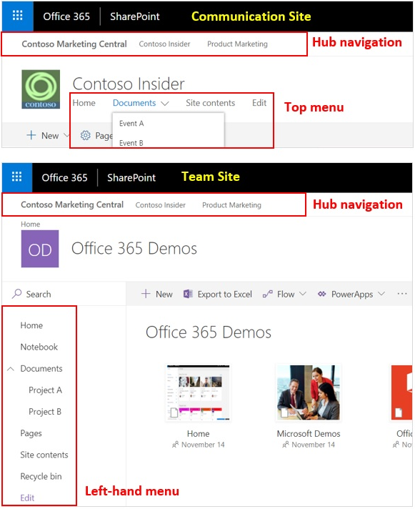
Overview of navigation in SharePoint (3/4)
Hub navigation for groups of related sites
Hub site navigation is displayed above the local navigation on each site, just below the suite bar. Hub sites provide a great way to achieve the cross-site navigation features previously available in managed navigation and site hierarchies in classic SharePoint.

Slide 22
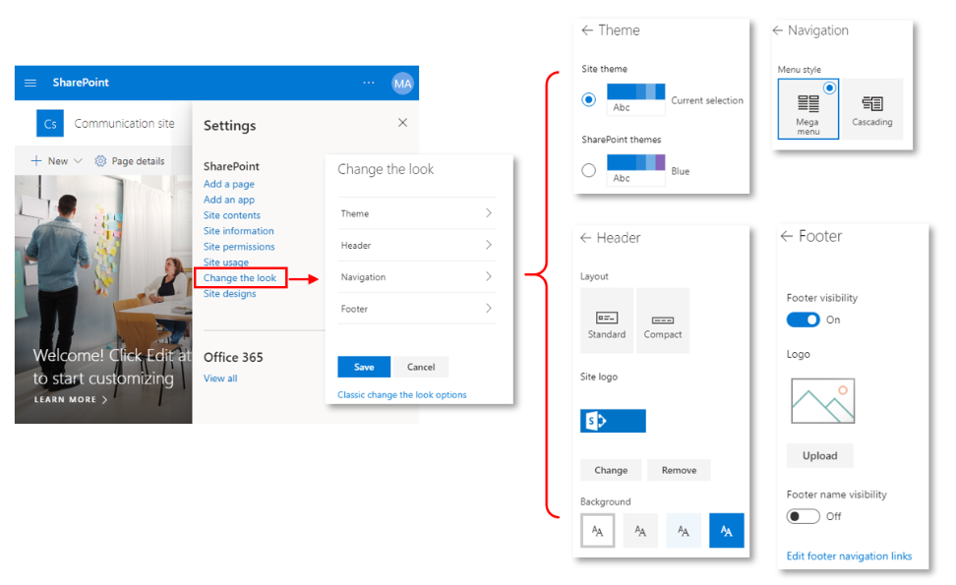
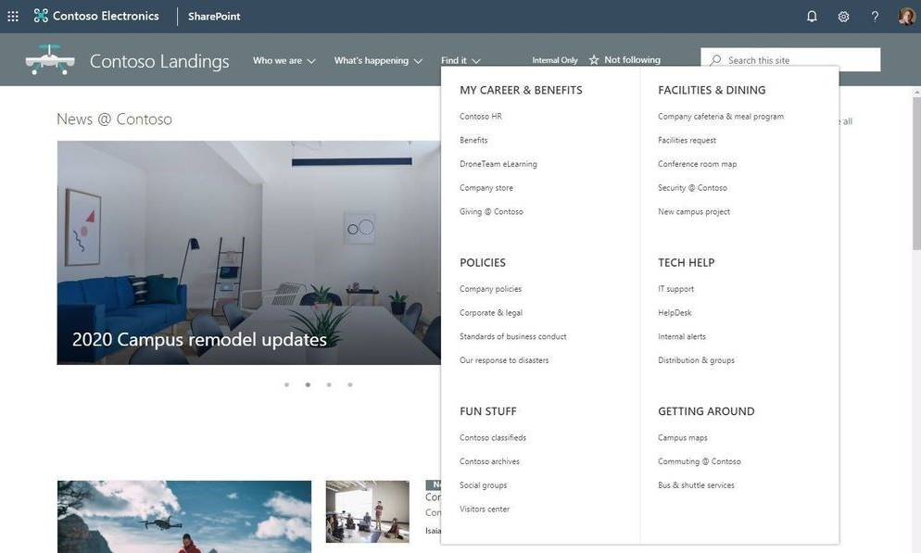
Overview of navigation in SharePoint (4/4)
Megamenu navigation
Megamenu navigation is a feature in “Change the look” options. It allows showing multiple levels of hierarchy at once. This will enable you to better organize and showcase the content and sites. The megamenu navigation layout is only available for horizontally oriented navigations and allows for a panel display of links up to three levels.

Slide 23
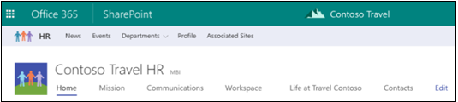
Overview of SharePoint hub sites
SharePoint hub sites provide the flexibility and help organizations by connecting and organizing sites based on project, department, division, region, etc.
Benefits of SharePoint hub sites
Shared navigation
Search across the hub
A home destination for the hub
News roll-up
Associated sites
Highlighted content

Slide 24
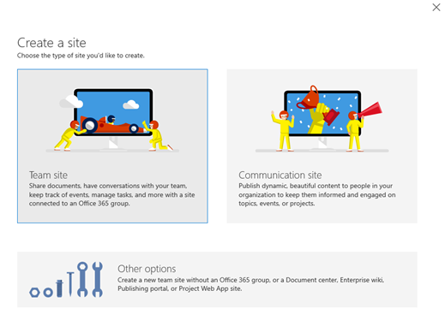
Create SharePoint sites
Microsoft 365 global admins and SharePoint admins can create SharePoint sites with different site templates. It is recommended to use modern SharePoint sites for new sites.
Create from the SharePoint admin center
Create from PowerShell
New-SPOSite
-Url https://contoso.sharepoint.com/sites/accounting
-Owner admin@contoso.com
-Template STS#0
-StorageQuota 100
-ResourceQuota 50

Slide 25
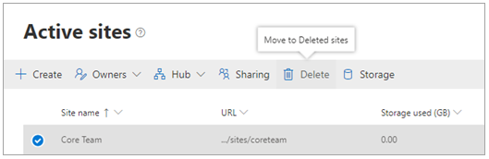
Delete SharePoint sites
Both global and SharePoint admins can delete both classic and modern sites, including sites that belong to Microsoft 365 groups. Deleting these sites will delete the group and all its resources, including the Outlook mailbox and calendar, and any Teams channels.
Delete a site
From the SharePoint admin center
From PowerShell
Permanently delete a site
From the SharePoint admin center
From PowerShell
Remove-SPOSite -Identity https://contoso.sharepoint.com/sites/site1
Remove-SPODeletedSite -Identity https://contoso.sharepoint.com/sites/sitetoremove

Slide 26

Restore SharePoint sites
Deleted site collections are automatically emptied from the site collection Recycle Bin after 93 days. You can restore a deleted site collection before this time.
Restoring a site that belongs to an Microsoft 365 Group restores the Microsoft 365 Group and all its resources. Note that the other group resources are retained for only 30 days, whereas the site is retained for 93.
Restore a site
From the SharePoint admin center
From PowerShell
Restore deleted items from the Recycle Bin
Restore a document library
Restore-SPODeletedSite -Identity https://contoso.sharepoint.com/sites/arecycledsite

Slide 27
Why do we need SharePoint Hub Sites
A dynamic, ever-changing digital workplace
We want to see things that are relevant
Navigate consistently and easily
Search in the context of where we are
Anyone can post news, comment or like items and read other’s news and comments
Constantly Changing Organisations
As administrators we need quick ways to restructure our sites
We need to be able to provision quickly as new requirements arrive
Customers always looking for a solution immediately.

Slide 28

Overview of SharePoint sites (3/4)
Hub sites
SharePoint hub sites are used to organize families of team sites and communication sites together. Every SharePoint site can be associated to a hub site, which is a flat structure of sites that share navigation, branding, and other elements.
SharePoint hub sites help you organize your intranet by connecting and organizing sites based on project, department, division, region, etc. making it easier to:
Discover related content such as news and other site activities.
Apply common navigation, branding, and site structure across associated sites.
Search across all associated sites.

Slide 29
Where we come from
IT
Lists
HR
Libraries
Pages
Project 1
Project 2
Project 3
Policies
Benefits
Lists
Project 4
Project 5
Libraries
Pages
Site Collection
Sub Sites

Slide 30
Where we are – Modern Experience
Modern Sites are ‘Site Collections’
Always better when they are connected
Companies are made up of smaller groups and teams
Customers want to organize sites into grouping that
Make it easier for users to discover and recall related content
Apply common controls, branding and polices.
Search together and group common news and contents.
No more deep site structures
Modern Site is a “Flat Architecture”
Hubs connect related sites
Sales Report
Site Collections
Yearly Report
News
Sales
Customer Report
Regional sales
Expense Tracker
Feedback
Benefits
Travel Policies
Record Center
HR
Guidance
New Hires

Slide 31



A dynamic, ever-changing digital workplace
Acquired sales
Travel innovation
Vendor agreements
Customer connections
Legal portal
Travel
Programs
Company-wide
Quarterly reports
Regional sales
Sales
Expense tracker
Cultural
Eco
Records center
Adventure
Benefits
planning
Big wins
Customer
Event planning
Benefits
Regional partner outreach
Recognition & rewards
New hires
EMEA
EMEA sales
Policies
key
HR
Hub site
Communication site
Team site
Partner solution
Custom portal

Slide 32
SharePoint Hub Sites
A solution for dynamically changing site structures
Brings together related Team sites and Communication Sites
Cross-site navigation / Global Navigation
Common look and feel across sites (Theme)
Logo
Rollsup News together
Combines site activities
Search across related sites
Admin create Hub Sites and site owners associate/join the hub site.
Sales Report
Yearly Report
Sales
Customer Report
Regional sales
Feedback

Slide 33
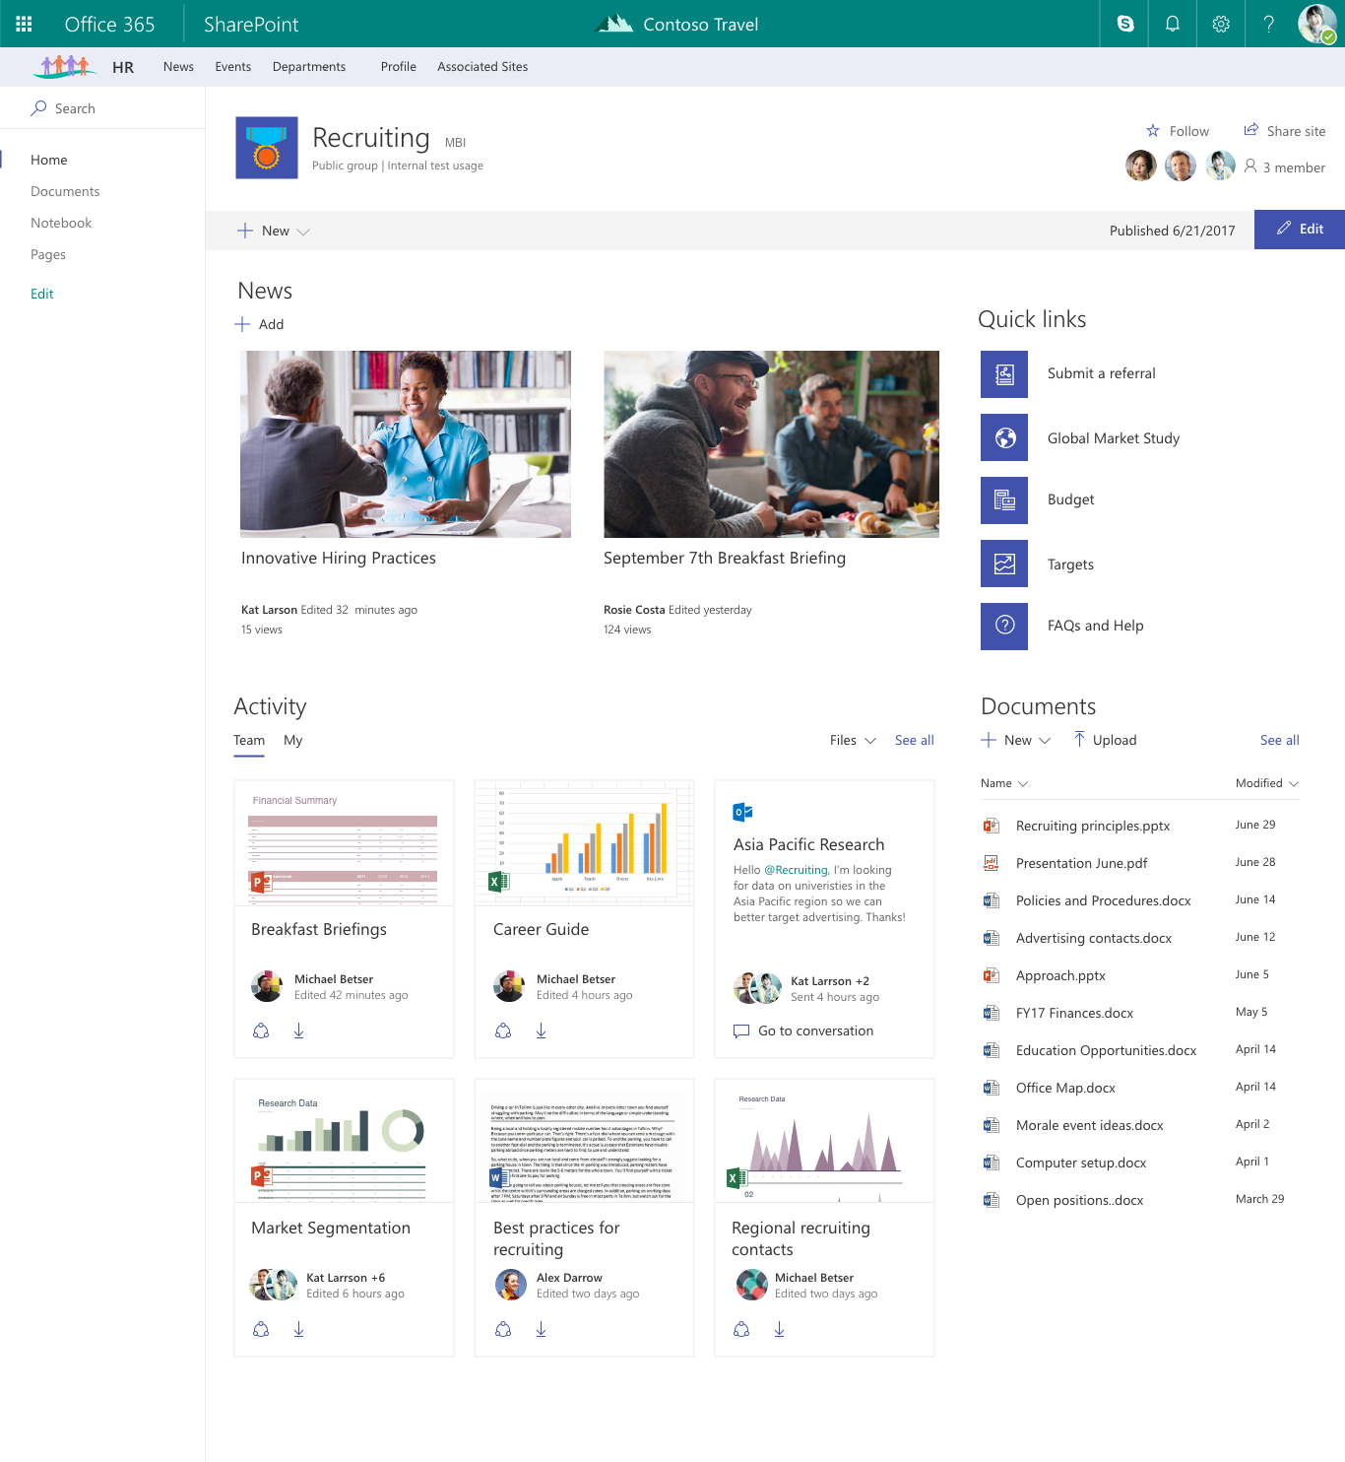

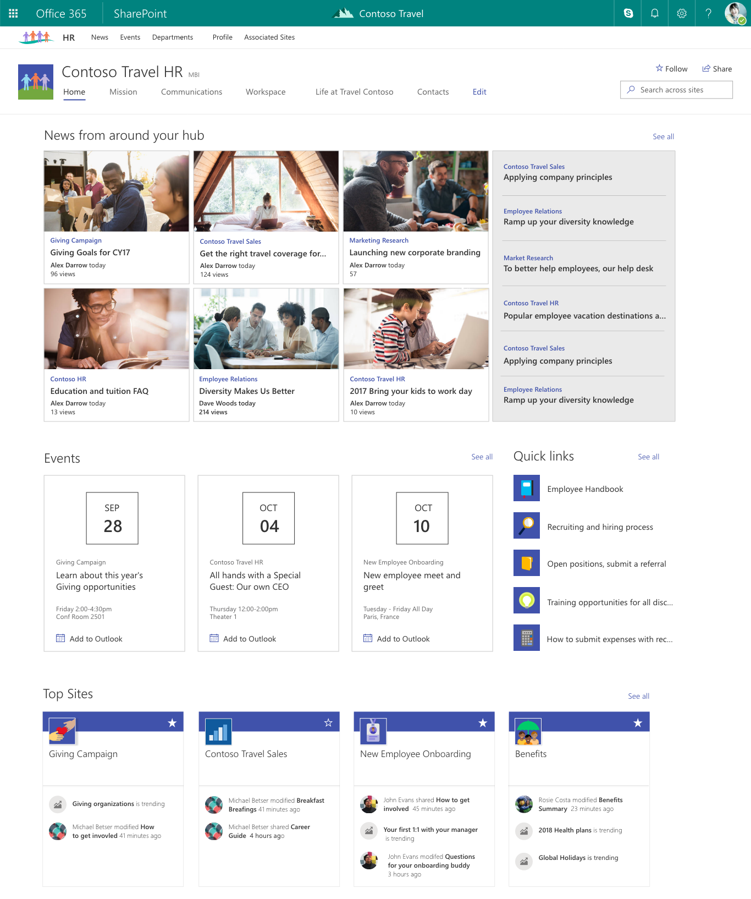
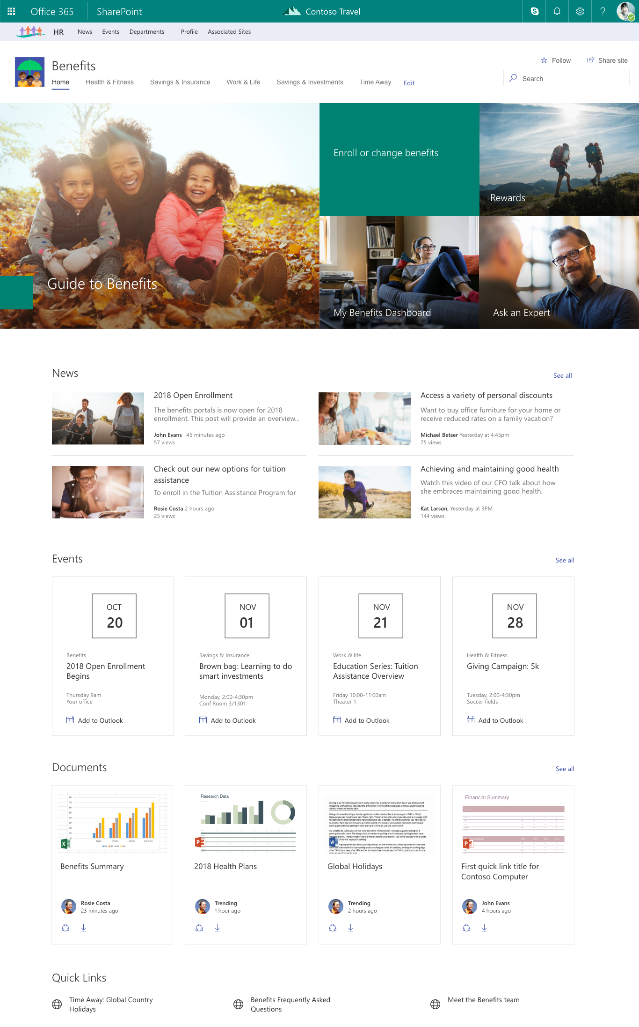
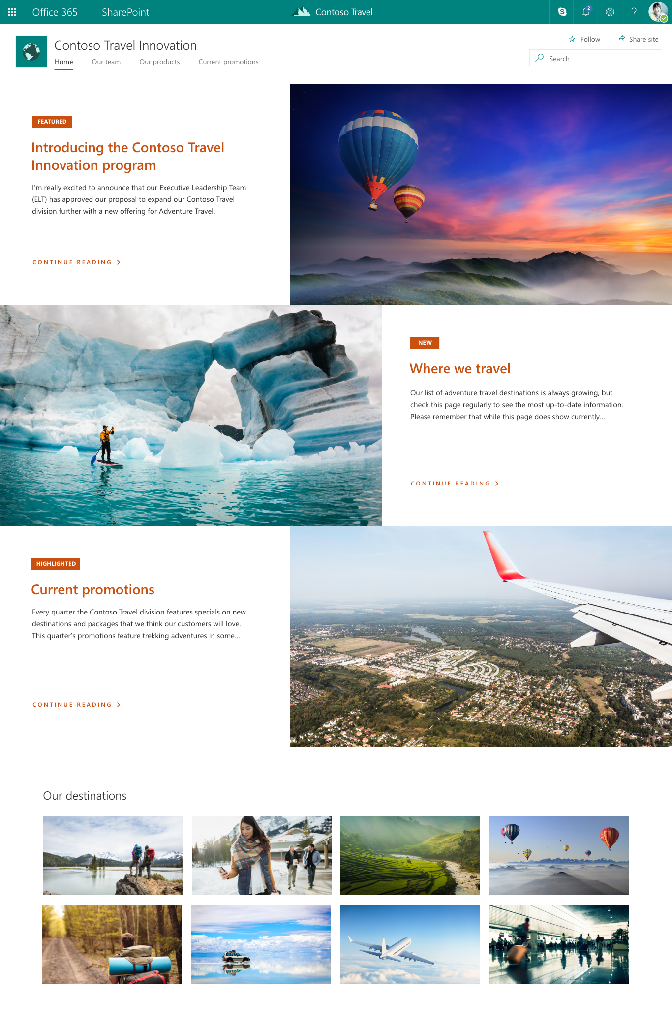
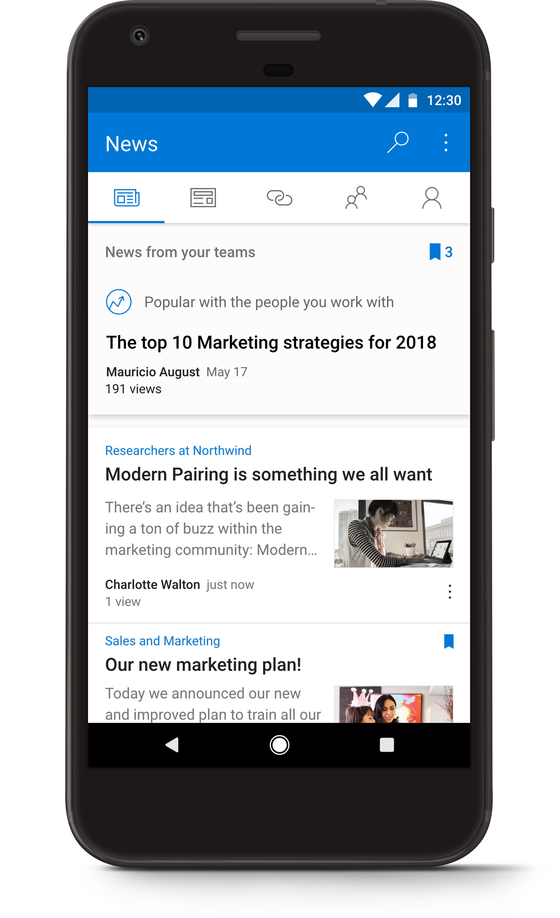
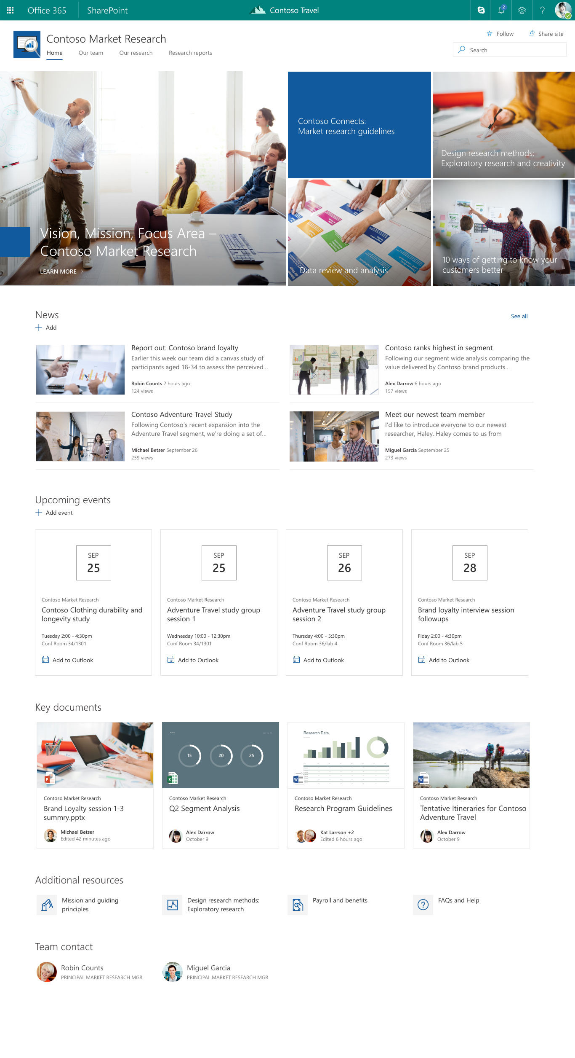
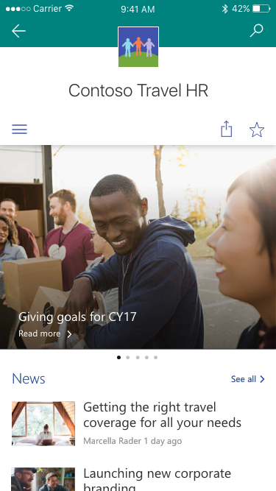
SharePoint Hub Sites – Quick Example
Team sites
Hub site
Communication sites
Benefits
today…

Slide 34
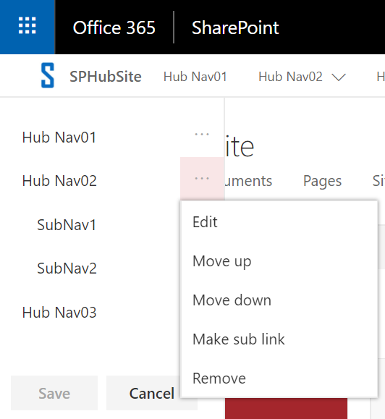
Global Navigation
Navigation configured in the Hub Site
The hub site navigation by default is static and you must have full control of the main hub site, and edit the navigation on that site.
Adding sites to the hub doesn't add them to the hub navigation
Associated sites inherit navigation from the Hub Site
Navigation is not security trimmed
If the user doesn’t have permission to the site, it will redirect to Access denied page.
We can build security trimmed navigation using SharePoint Framework (SPFx)
Can take time for the navigation to appear in the associated sites
Supports drop down items and Mobiles

Slide 35
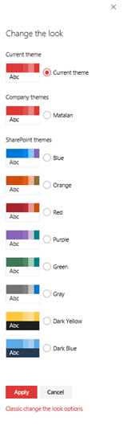
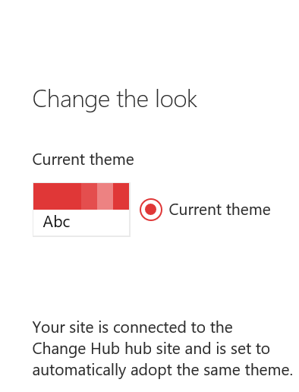
Logo and Site Theme
Associated sites inherit logo and site theme from the Hub Site
Across associated sites use the same logo, look and feel
We can’t change the associated sites theme. It always inherits from the hub sites
While disconnecting from one Hub and connecting to another hub, automatically updates the new Hub site theme
If you remove the association and select none, theme will not change automatically
When selecting a new theme, a customize option appears

Slide 36
News Rollup
All associated sites’ news rollup to Hub sites
News can be created on the Mobile App
There is a delay because it depends on Search crawling the content
Comments and likes appear in both the Hub and source site immediately
Current Limitations:
News cannot be scheduled
No approval process
Hub Sites
Sales
Finance
IT

Slide 37
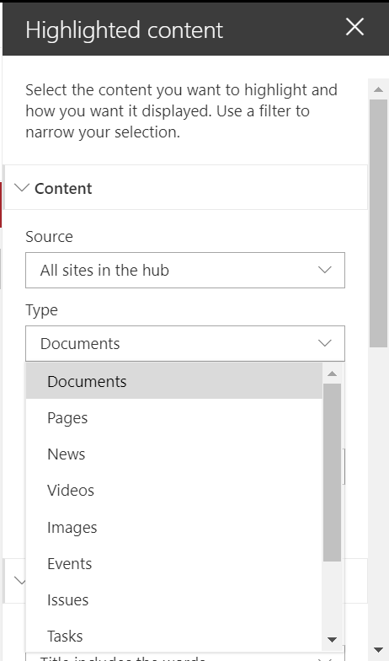
Highlighted Content Webpart
Content roll up from sites connected to the Hub site
Rollup content based on Content Type
Supports Filtering and Sorting
Rollup Documents, Lists, Pages, News, Videos, Events, Issues,
Tasks and Links
Links to recent activities

Slide 38
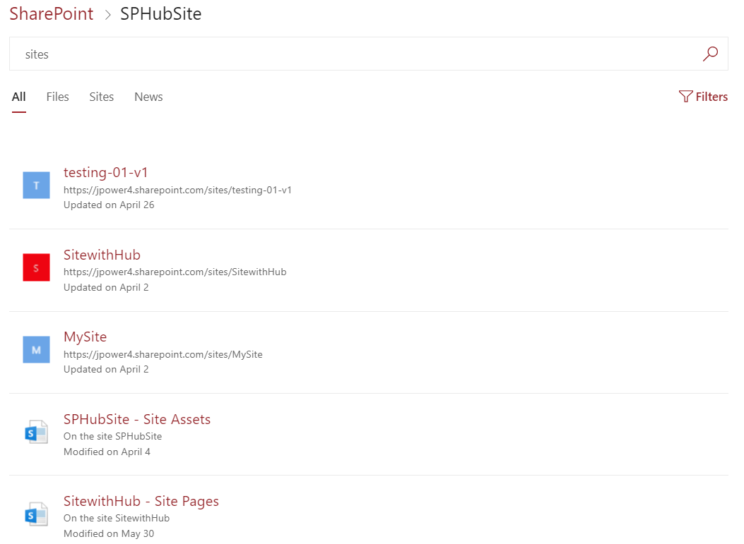
Search
Search scoped to connected Hub sites
Security trimmed
New default result sources:
All
Sites
Files
News

Slide 39
Security
Associated sites cannot inherit security from the Hub Site
Security should be configured individually per site collection
Permissions must be configured on connected sites individually
Use groups to apply permission across Site Collections
Content rollup, News and search is security trimmed

Slide 40
Demo – Creating a Hub Site
Step 1: Create a Communication Site or Team Site
Step 2: Register the site as a Hub Site
To Register Hub Site we need admin permission, only administrator can register the site as Hub site using PowerShell
Use SharePoint Online PowerShell Console, download the Latest version.
To Connect the admin site
PS C:\Windows\system32> connect-SPOService -Url https://tenant-admin.sharepoint.com
PS C:\Windows\system32> Register-SPOHubSite –Site https://tenant.sharepoint.com/sites/hubsitename
To grant permission while registering hubsites
Register-SPOHubSite -Site https://tenant.sharepoint.com/sites/hubsitename -Principals ‘user@domain.com’

Slide 41
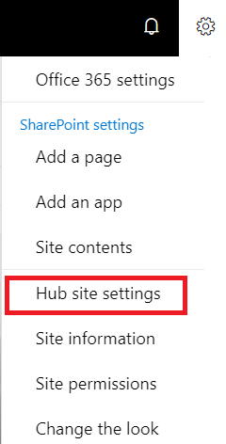
Demo – Hub site settings
Click the Cog and then choose ‘Hub site settings’ to change the logo
Click the cog and then ‘Change the look’ and select the Theme and customize it.
Add the Global Navigation

Slide 42
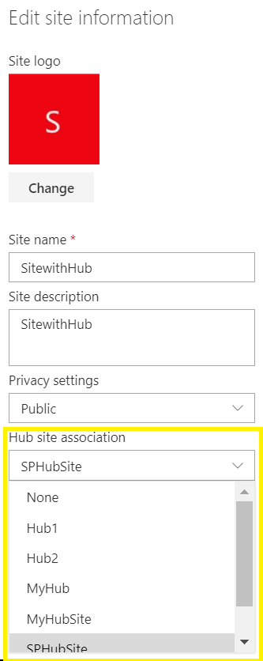
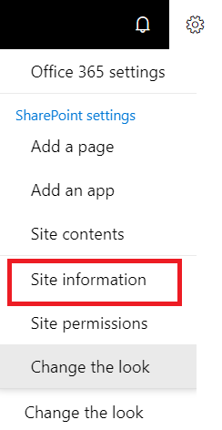
Demo – Associate sites with Hub sites
Step 1: Create a Communication or Team Site
Step 2: Click the cog and the select ‘Site information’
Step 3: Select the Hub Site to associate with.
Using Powershell
Step 1: Connect the Admin site
PS C:\Windows\system32> connect-SPOService -Url
https://tenant-admin.sharepoint.com
Step 2: Associate the site with Hub
PS C:\Windows\system32> Add-SPOHubSiteAssociation https://tenant.sharepoint.com/sites/projects -HubSite https://tenant.sharepoint.com/sites/hubsite

Slide 43
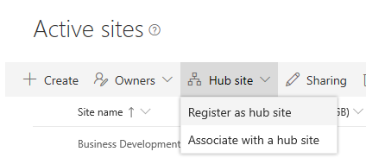
Configure SharePoint hub sites (1/2)
Phase 1: Create a new hub site
To create a hub site, a global admin or SharePoint admin essentially converts an existing SharePoint site to a hub site. It's recommended to select a communication site or a team site that uses the modern template.
Phase 2: Design the hub site
Once the hub site has been created, the hub site owner can start designing the hub site for applying common navigation and branding across all associated sites.
Phase 3: Associates/Disassociate a site with a hub site
Once the hub site been created and configured, we can associates/disassociate sites with the hub site. There are three ways to associates/disassociate a site with a hub site

Slide 44
Configure SharePoint hub sites (2/2)
Phase 4: Remove a site's hub site status
If you are a global admin or SharePoint admin in Microsoft 365, you can demote a hub site (remove its hub site status) by using PowerShell. Make sure you do this before you delete the hub site. When you demote a hub site, any sites still associated with the hub site will be automatically disassociated.
cmdlet | Description
Add-SPOHubSiteAssociation | Adds a new association between a site and a hub site.
Remove-SPOHubSiteAssociation | Removes an association between a site and a hub site.
Get-SPOHubSite | Lists hub sites or hub site information.
Grant-SPOHubSiteRights | Grants rights to users or security groups to access the hub site.
Register-SPOHubSite | Enables the hub site feature on a site to make it a hub site.
Revoke-SPOHubSiteRights | Revokes rights for specified principals to a hub site.
Set-SPOHubSite | Sets the hub site information such as name, logo, and description.
Unregister-SPOHubSite | Disables the hub site feature on a site.
The following PowerShell cmdlets are available for managing hub sites

Slide 45
Site Performance
Don't:
Build custom client-side controls that issue client-side data requests to SharePoint and add a dozen or more of them to the page.
Implement your client-side controls without centralized data access to the SharePoint data, so that numerous controls are requesting exactly the same data numerous times on a page.
Embed redundant custom JavaScript and CSS throughout the page body.
Embed several 10-MB thumbnail images throughout the page body.
Execute all client-side data requests at page-load time, even if the data is not initially needed or displayed, even if it might never be used.
Inject unnecessary order dependencies into the data request sequence and use synchronous data requests to ensure the order of execution.
Use the legacy SharePoint Lists (SOAP) web service as the data request API of choice and pass it poorly-formed CAML queries.
Avoid caching data responses (especially for static data) on the client to ensure that each data request gets re-executed on every page load.
Perform hundreds of updates to the Document Object Model (DOM) of the page as each data response completes, even if they are redundant or conflicting.

Slide 46
SharePoint Online
Best practices
Governance
Compliance and security
Data loss Prevention
Multi-lingual site strategy

Slide 47
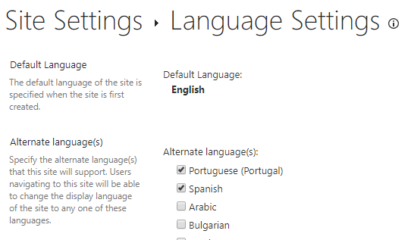
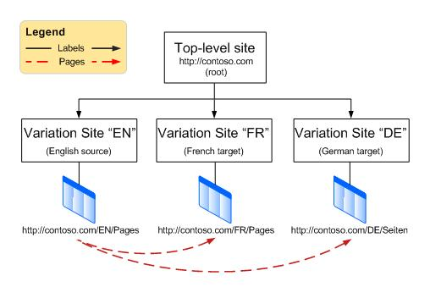
Multi-lingual site strategy
Go to Site Information > View All Site Settings > Language Settings
Enable pages and news to be translated into multiple languages
Select the users that will be your translator(s) for the pages (tip: you can use Office 365 groups here too!)
Click Save

Slide 48
Branding and theming in SharePoint

Slide 49
SharePoint site theming
Like the Microsoft brand palette, the SharePoint themes are designed to build on the Microsoft brand, while at the same time allowing for flexibility to enliven your partnerships without dominating them. They reveal shared goals and personality, and they reflect diversity and ability to optimize the SharePoint experience
Notes:
Explain SharePoint site theming.
https://fabricweb.z5.web.core.windows.net/pr-deploy-site/refs/heads/master/theming-designer/index.html

Slide 50
SharePoint site theming
Theming experience components:
Color palette
Master page preview
Font scheme
Composed look
Background image
Change the look
Master page
Design gallery
Notes:
Explain SharePoint site theming.

Slide 51
Site design and site scripts
Use site designs and site scripts to automate provisioning new or existing modern SharePoint sites that use your own custom configurations:
Site designs
Site script
Use PowerShell or REST to work with site designs and site scripts
Scoping
Notes:
Explain Site design and site scripts.

Slide 52
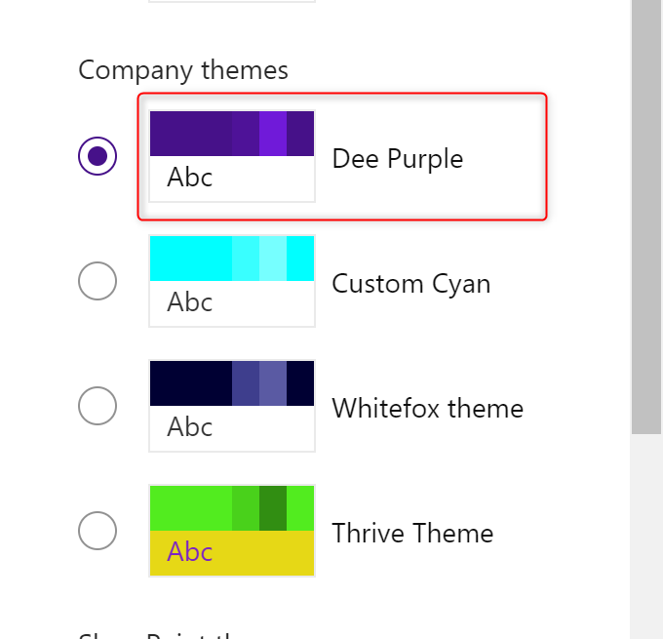
Site design and site scripts
Notes:
Explain Site design and site scripts.
Site Design GitHub Examples
https://github.com/SharePoint/sp-dev-site-scripts

